Slide 1
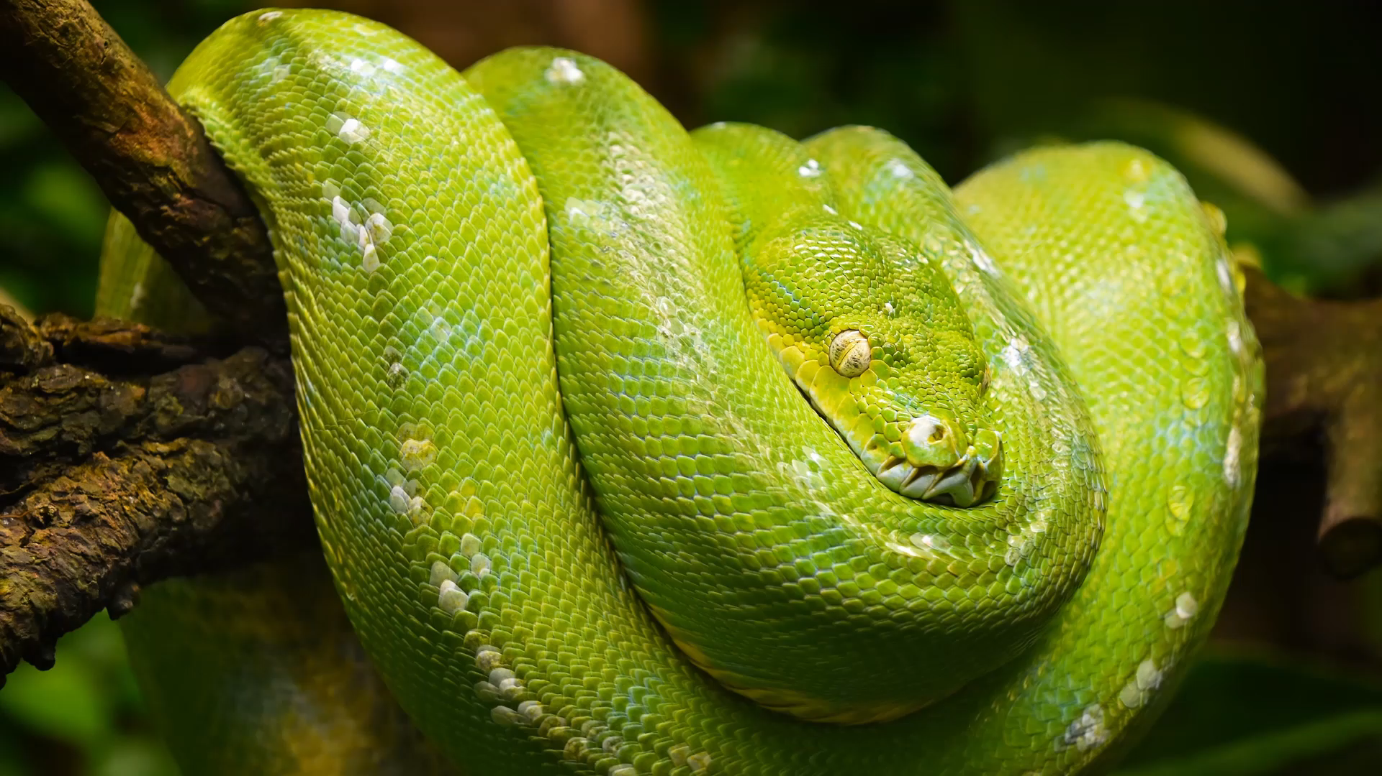
Collaborative Scientific Python
Code like a modern geophyisicist – Day 1

Slide 2

Preliminary: Pizza order

Slide 3
Course objectives
Reach working fluency for collaborative projects with Git
Download files, fork/branch projects, submit pull/merge requests
commit+push tracked changes, fetch+pull new versions
Run and manage projects with peers and collaborators
Have an understanding and practice of basic scientific Python
Discover and use Pandas, Matplotlib, Numpy, Cartopy, Scipy, etc.
Be able to read-in, pre-process, analyse and visualise data
Groom and utilise these skills all along studies and future career

Slide 4
Program
Day 1 - Introduction
Theory on Git for programming
Some comments on teaching and learning
Short survey
Installation and setup
Day 2 - Scientific Python
Demonstration by researcher
Practice and exercises
Get everyone to the required level
Days 3 & 4 - Collaboration
Scientific group projects
Collaborate in teams and between different teams
Day 5 - Reflections
Present and discuss results with expert
Short survey

Slide 5
GFI course structure

Slide 6
Current challenges and status quo
Programming is necessary in scientific studies and careers
Students:
Unclear uses and benefits, not sure where to begin
Lack of training with programming routines, no repetition and continuity
Only INF100 formally covering the topic and not totally applicable to GFI
Different competing frameworks (CoCalc, Anaconda, VSC, etc)
Teaching staff:
Mostly involved with MatLab or Fortran in research, not always Python
Programming teaching goals not clearly defined
Creating lectures that include programming (new designs and practices)
Programming complex to teach (semantics, use cases, packages, etc)

Slide 7
A new perspective on it
Git + Visual Studio Code as a framework
Provide students with professional skills
Robust collaborative capacities, supports integrating programming into all courses
Transparency about workflow and individual contributions
Shared documents always up to date for everyone
Git
Cloud-based Version Control System, tracks all changes to a file/project
Records who made what change when and why
Visual Studio Code
Free & open-source code editor/interpretor/compiler synchronised with Git
Supports 100+ programming languages, more than 45000 extensions, most popular coding environment (74% of 71000 respondents in 2022)

Slide 8
Research on using Git in programming
Advantages
Collaboration: improves communication and teamwork skills
Version control: track changes and revert to previous versions if necessary
Feedback: pull-request feature is a platform for discussion between users
Transparency of activity: holds users accountable for their contributions
Opportunity: students develop technical skills at industry-standard
Limitations
Learning curve for beginners unfamiliar with Git-environment
Unthinkable to have a degree in geophysics without robust coding skills
Develop shared base of knowledge
May not be suitable for grading assignments
Grade student work on mitt.uib
Some may be uncomfortable sharing work
Possibility to use private repositories at any time
Zagalsky, Alexey et al. “The Emergence of GitHub as a Collaborative Platform for Education.” (2015)
Kertész, Csaba. “Using GitHub in the classroom - a collaborative learning experience.” (2015)
Feliciano, Joseph et al. “Student experiences using GitHub in software engineering courses: a case study.” (2016)
Glazunova, Olena G. et al. “The effectiveness of GitHub cloud services for implementing a programming training project: students’ point of view.” (2021)

Slide 9
What the community does (3/23)
Gif-based repositories at GFI for GEOF211, GEOF212, GEOF321, GEOF337, GEOF105
“strong tool for shared projects […] with well-structured way to decide of changes”
“shifting the access of the course material to Git[Hub] would certainly be a great step”
“the repository can live on, beyond my association with the course”
“I can more easily track the development of the course materials”
“perfect for sharing my Jupyter notebooks”
Worldwide:
100+ million developers, 386+ million repositories
New industry standard for programming and data management
40+ million public repositories, 1700 hits ‘climate models’, 1000 hits ‘oceanography’, 2600 hits ‘meteorology’

Slide 10
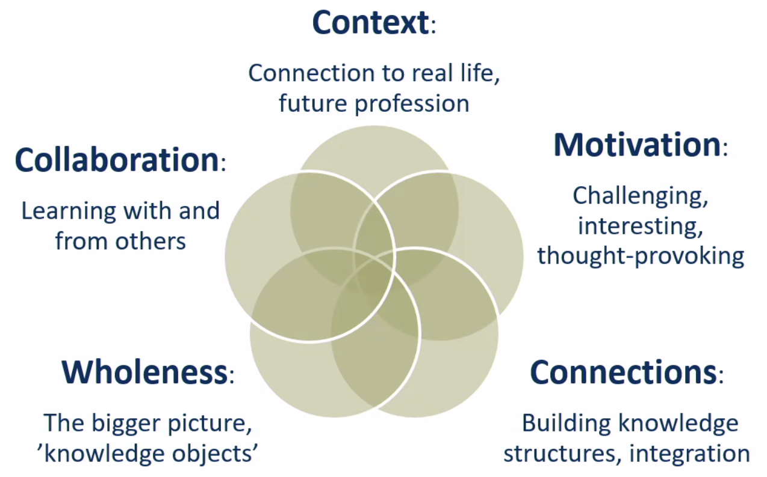
Meaningful learning (what)
Extrinsic: external drivers, achieve a certain goal
Intrinsic: genuine interest, enjoyable
Weurlander, Maria et al. “Meaningful learning: Students’ perceptions of a new form of case seminar in pathology.” (2009)

Slide 11
Learning to learn (how)
Goal not content alone, but to develop as a learner: capable to find new approaches and information, and apply these in an effective manner:
Online ressources, communication with peers, creative skills
Self-determined learners able to be effective and seek out knowledge
Recommendations of DBER on instruction:
Encourage student participation
Involve student in collaborative activities
Supplement instruction with tutorials
Blaschke, Lisa Marie. “Heutagogy and lifelong learning: a review of heutagogical practice and self-determined learning.” (2012)
Singer, Susan R. “Discipline-Based Education Research: Understanding and Improving Learning in Undergraduate Science and Engineering.” (2012)

Slide 12
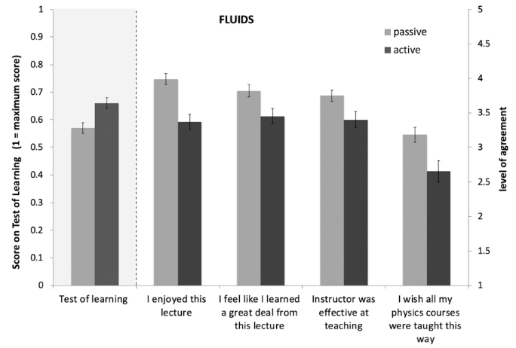
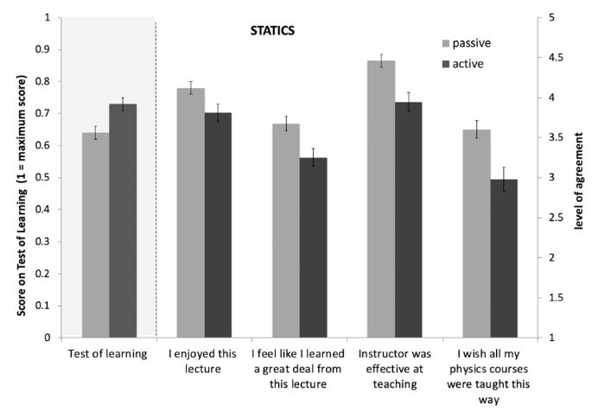
Active learning (why)
Deslauriers, Louis et al. “Measuring actual learning versus feeling of learning in response to being actively engaged in the classroom.” (2019)

Slide 13

Student survey
https://skjemaker.app.uib.no/view.php?id=17037235

Slide 14

Dinner
Notes:
pizza

Slide 15
Setup: Gitlab and structure
Get added to the course project on git.app.uib.no/gfi through your Feide login credentials
Course Group
Sub-Group 2
P 2
P 3
Sub-group 3
Sub-group 1
Project 1
P 4
P 5
Project (Git repository)
Abc.py
Def.ipynb
Ghi.csv
Jkl.md
Mno.txt
Pqr.py

Slide 16
Installation: Python & Conda & Git
Check if you already have Python & Conda installed:
Open the Terminal (possible in VSC) and run: python --version conda --version (then conda update conda)
If you don’t have any of them yet, download Python & Conda:
Go to python.org/downloads & docs.conda.io/projects/conda/
Click on Download
Install according to the installer
Windows users: Make sure to add conda to PATH during the installation or add it manually afterwards (see geeksforgeeks.org/how-to-setup-anaconda-path-to-environment-variable)

Slide 17
Installation: GFI environment & packages
Create a GFI conda environment:
conda create -n GFI
Activate your environment: conda activate GFI Install all the necessary packages by running:
conda install numpy pandas matplotlib scipy scikit-learn cartopy

Slide 18
Installation: Visual Studio Code
Download VSC software:
Go to code.visualstudio.com
Click on Download, select appropriate OS license, confirm
Install according to your OS, launch VSC
Install some extensions:
Python/isort/Pylance/Python debugger/etc.
Jupyter/Jupyter Keymap/Notebook Renderers/Slide Show/etc.
Optional: Rainbow CSV/Excel Viewer/etc.
Windows users:
[Ctrl+Shift+P] → Configure Terminal Settings → Default Profile: Windows = bash
When using conda in git bash. Type: conda init bash and restart the terminal

Slide 19
Installation: GitHub Desktop
Download GitHub Desktop software:
Go to desktop.github.com
Click on Download, select appropriate OS license, confirm
Install according to your OS, launch GitHuB Desktop
When asked about your GitHub sign-up
Press [Skip this step], you can do this later
Create a local identifier (name and email address)

Slide 20
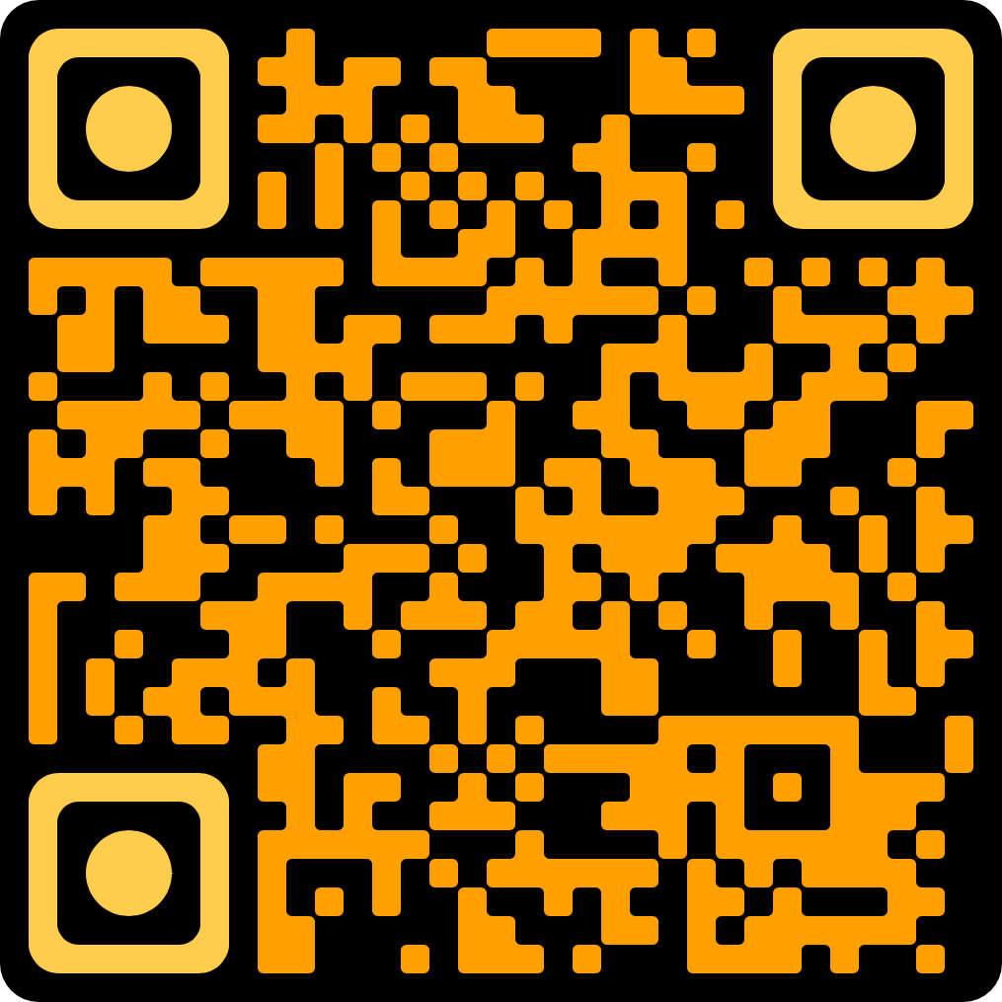
Gitlab x VSC synchronisation
Online search keywords: “How to use Github Desktop with Gitlab”

Slide 21
Basic Git commands
Copy repository
Clone to create local version of your online repository (cloud → local)
Branch to create divergent path from your main repository to isolate new work (internal, specific)
Merge request to ask to incorporate changes of specific branch into main branch
Fork to create separate copy of someone else’s main repository (external)
Pull request to ask to incorporate changes of fork into main repository
Upload changes
Commit to add change (+ description of change) to local change-log (local → local)
Push to publish local change-log to online repository (local → cloud)
Download changes
Fetch to retrieve online change-log (cloud → local)
Pull to merge changes of retrieved change-log with local repository (local → local)

Slide 22
Collaborative Scientific Python
Code like a modern geophyisicist – Day 2

Slide 23

How a researcher does it Vår Dundas Air-ocean interactions in the Antarctic Seas

Slide 24

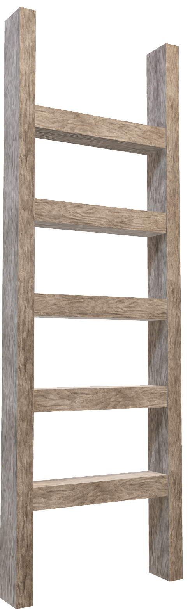
Scientific Python refresher
Create personal project on Gitlab:
CSP > Participants → New project (name=[your name])
Gitlab: Day 2 - Python exercises
Code → Download directory (zip), copy to your personal project
Exercises ranked according to difficulty (1–easy, 10–complex)
Level 7 is Master exercise (threshold)
Try level 7 and estimate your place on the ladder from there
Work yourself up the ladder during the session!
Master exercise

Slide 25
How to get files (Day 2, exercises)
Download zip from course folder, unzip and paste into personal folder in Participant subgroup
Clone both course folder and personal folder, copy paste exercises from former to latter, synchronise with Gitlab
Branch exercises from course folder into personal folder

Slide 26
HTTPS authentification for Gitlab x VSC x GHD
Collaborative Scientific Python (Gitlab group)
Access token 1 (global)
Global course files (Gitlab project)
Access token 3
Participants (Gitlab subgroup)
Access token 2 (specific)
Python exercises (Gitlab project)
Covered by Access token 3

Slide 27
Going futher…
What would a complex scientific exercise of geophysics look like?
Come up with a Python-based scientific exercise, submit it to the Python exercises folder
How could a group of people best collaborate in such an exercise?
Create a small protocol imagining a distribution of roles and tasks, submit it to the Python exercises folder

Slide 28
Collaborative Scientific Python
Code like a modern geophyisicist – Day 3

Slide 29
Previously on CSP… (S1E2)
3 ways to get exercise files…
Download zip from course folder, unzip and paste into personal folder
Clone both Course and personal folders, locally copy paste exercises
Branch exercises from course folder into personal folder
Access tokens…
Collaborative Scientific Python (Gitlab group)
Access token 1 (global)
Global course files (Gitlab project)
Access token 3
Participants (Gitlab subgroup)
Access token 2 (specific)
Python exercises (Gitlab project)
Covered by Access token 3

Slide 30
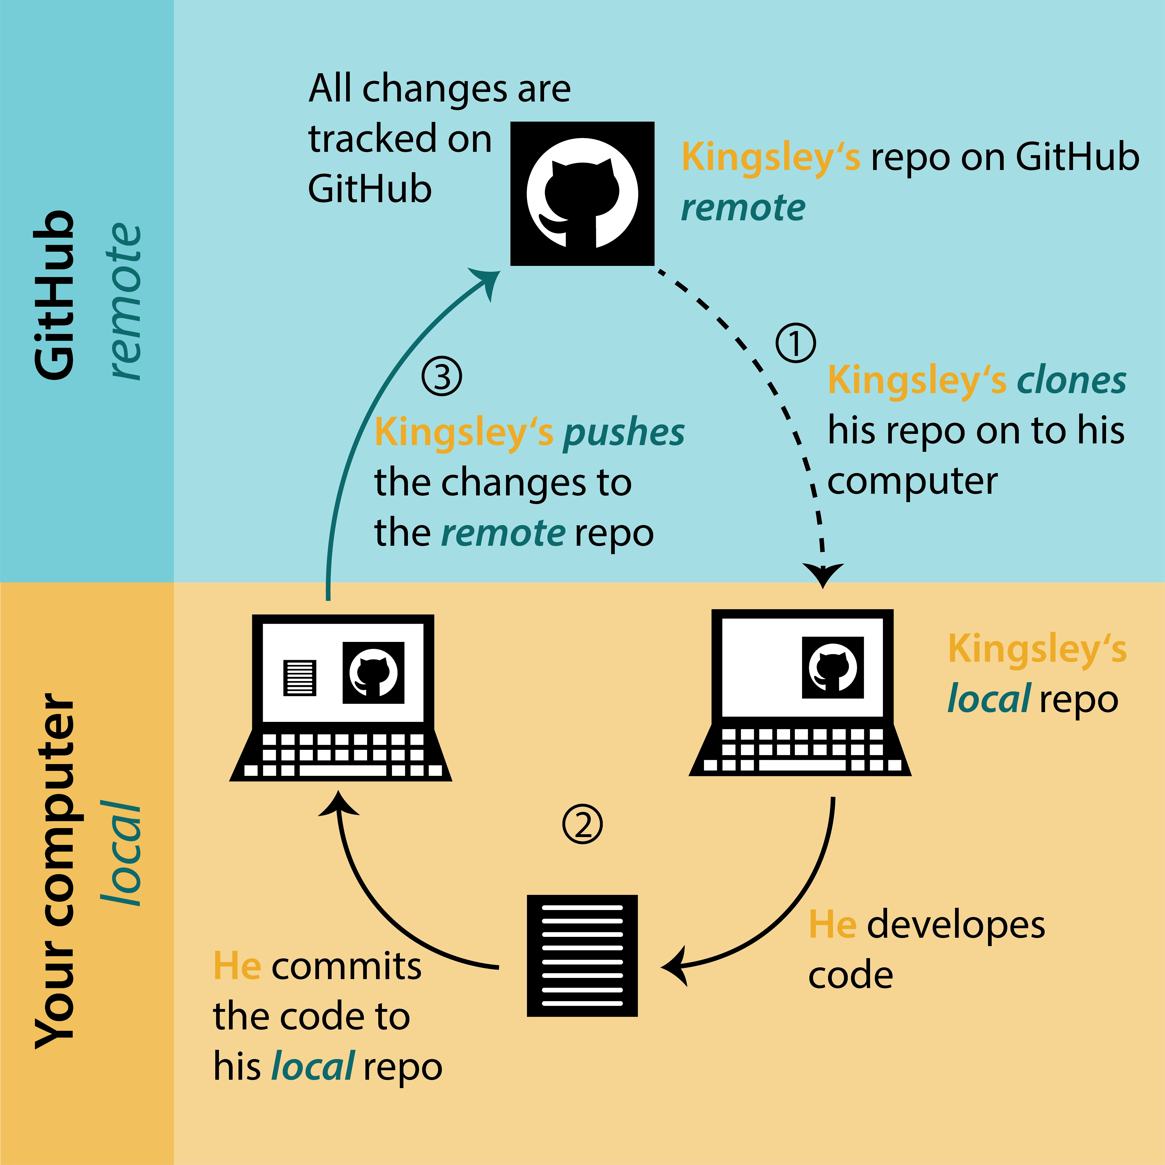
General workflow
repo - short for repository
repository - the directory or folder that is under version control
local - the repository on your computer
remote - the repository on GitHub
commit - take a snapshot of one or more files in the repository
push - send commits from the local repo to the remote repo
pull - retrieve commits from the remote repo to the local repo
biostats-r.github.io

Slide 31
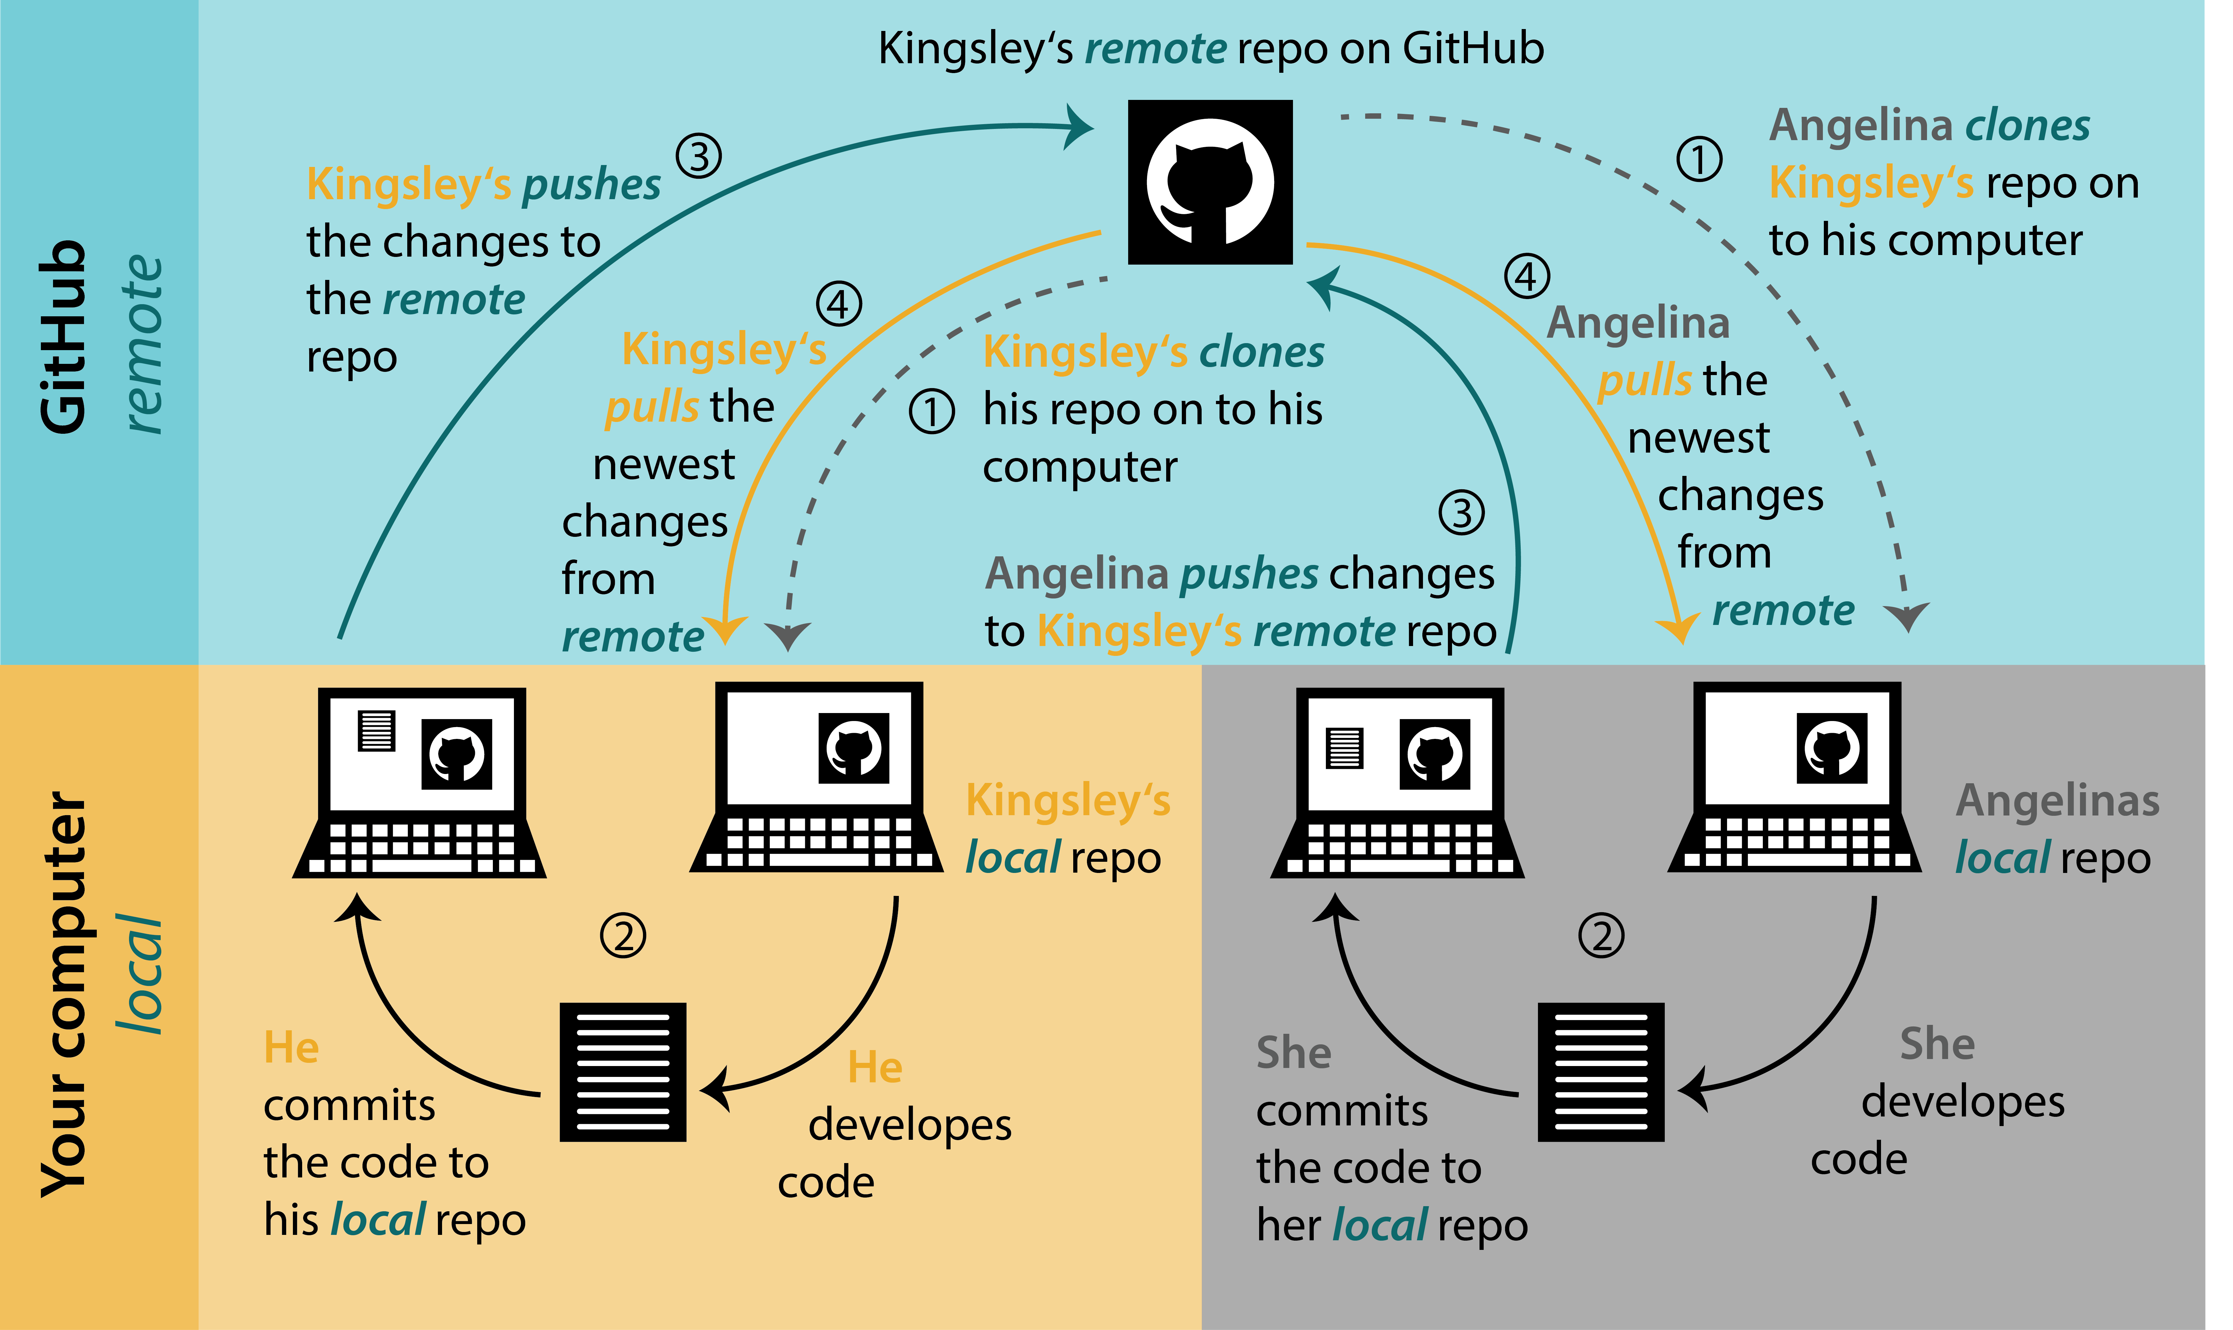
Shared repositories
Regular pulling/pushing very important to avoid merge conflicts!
biostats-r.github.io

Slide 32
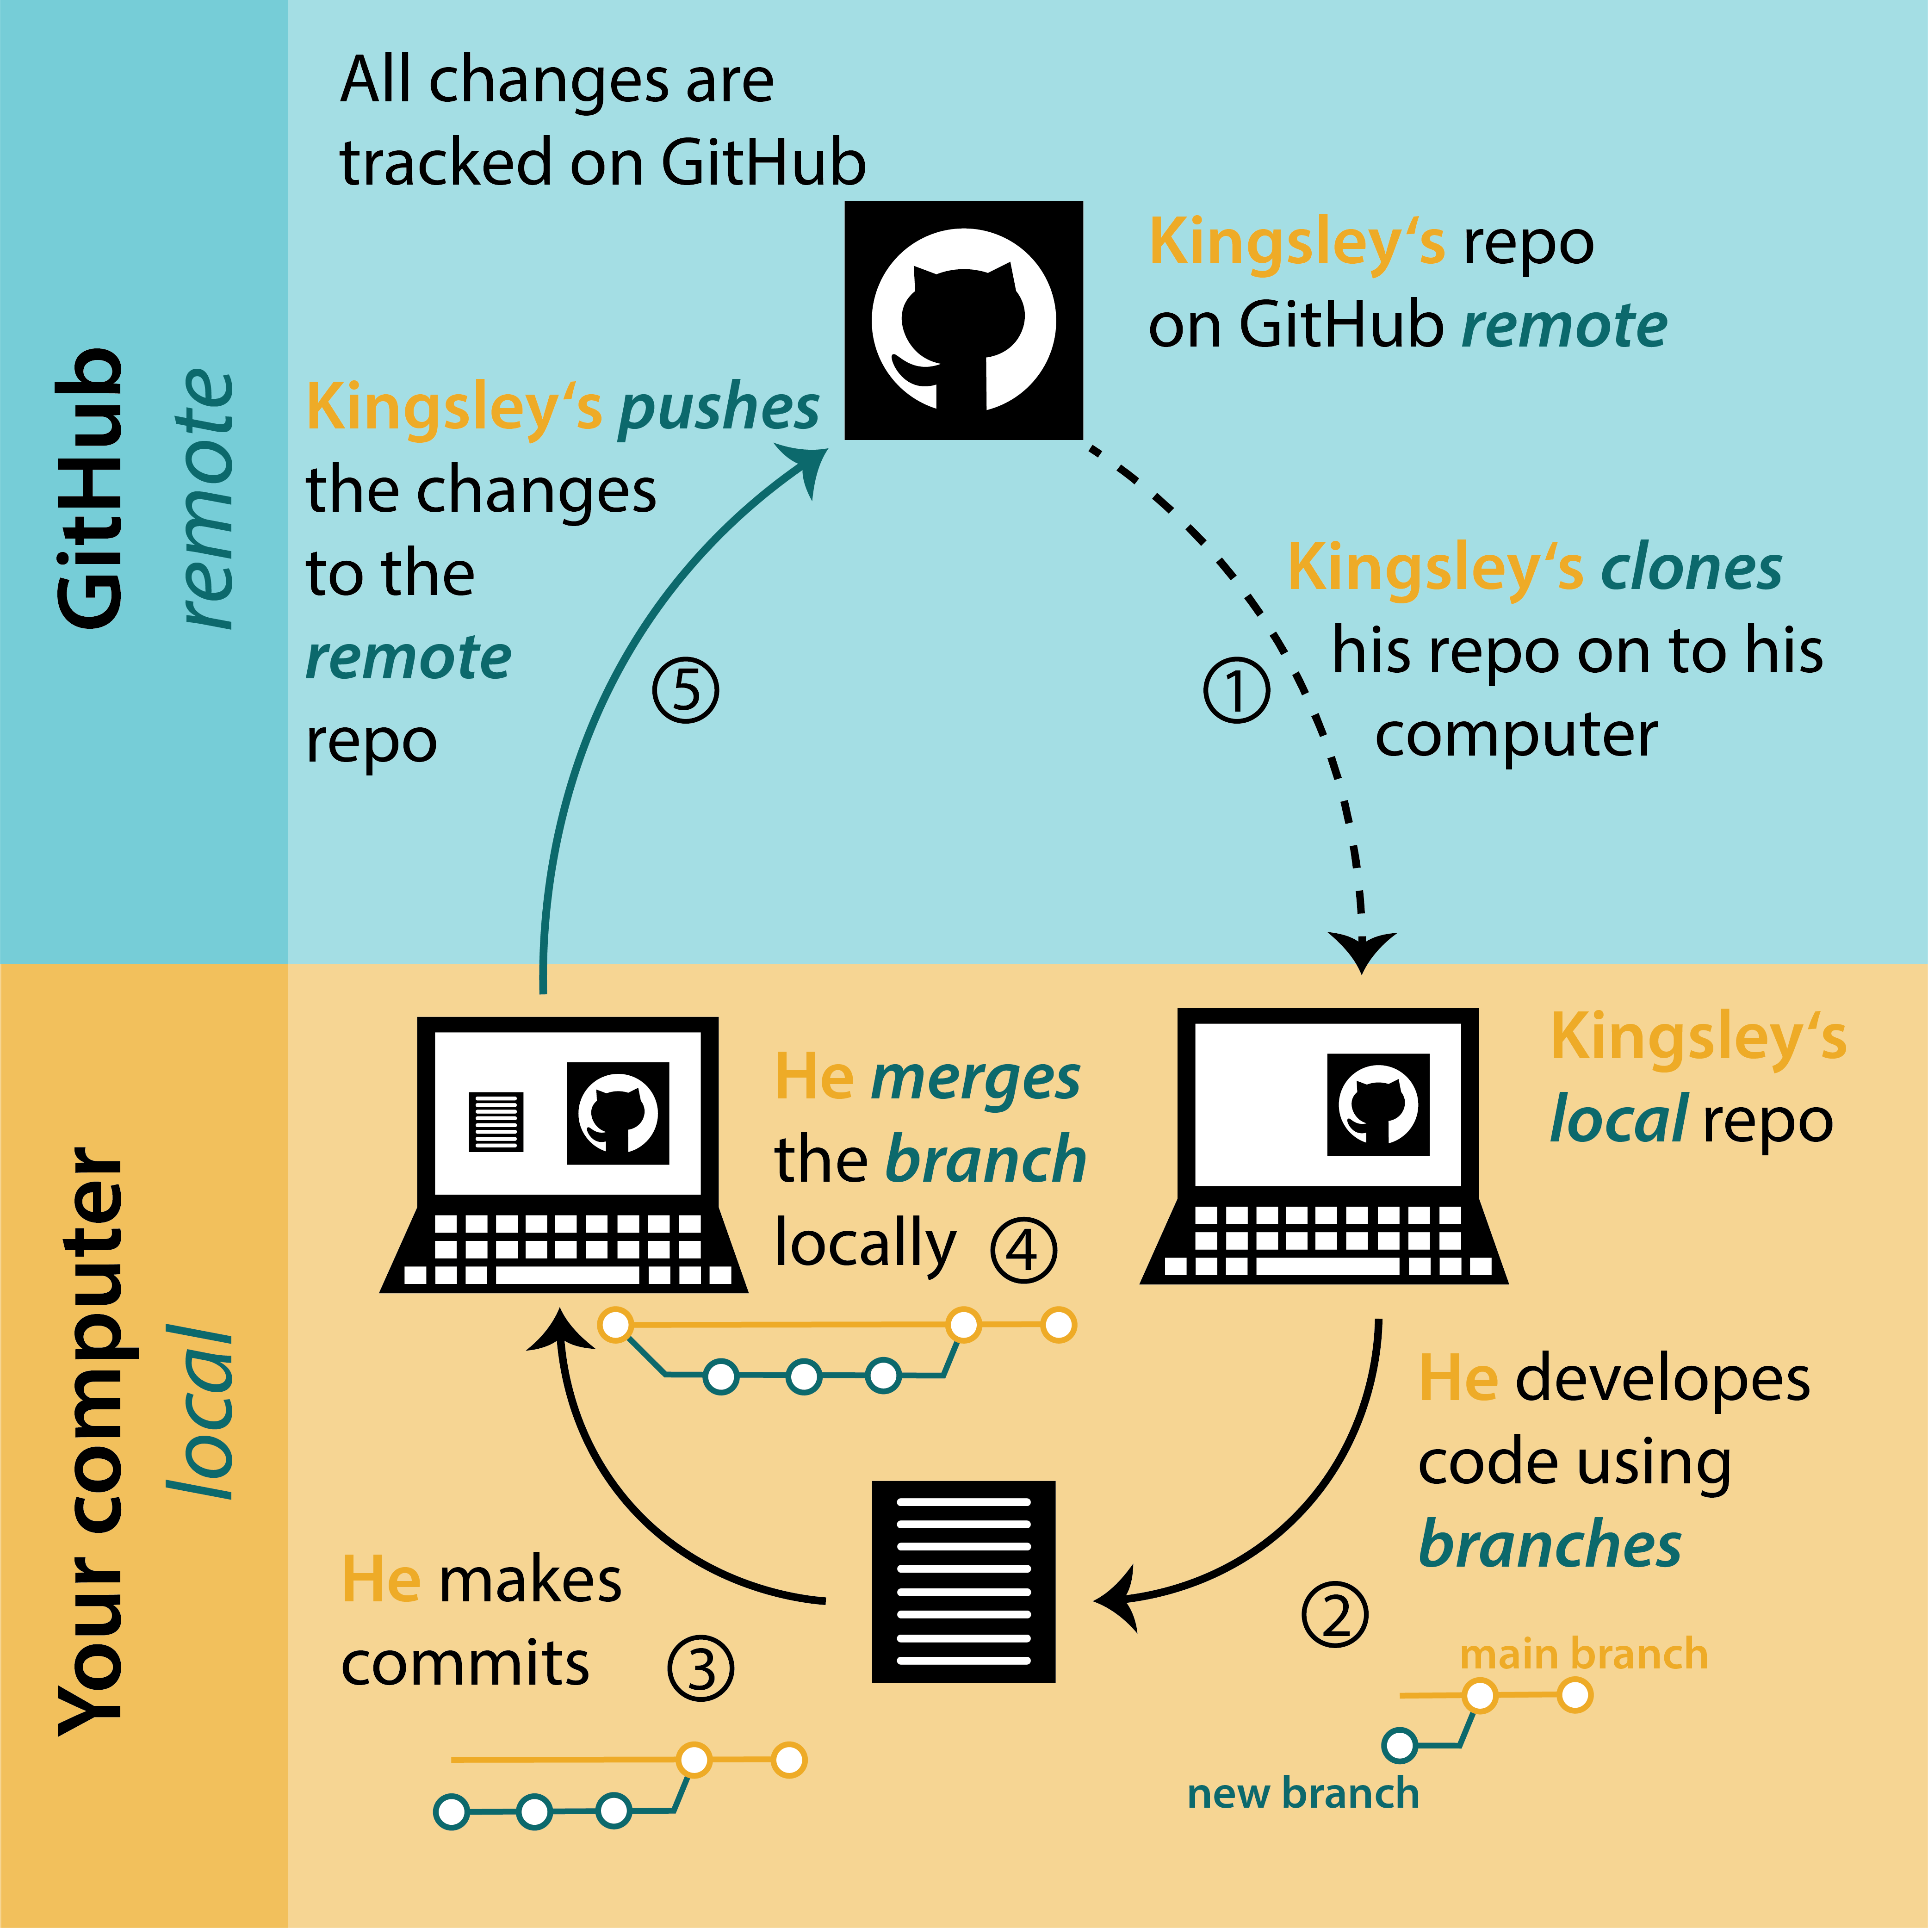
Working with branches
Branch to develop code, fix problem, or test idea without affecting main original project
Once happy with new code, problem fixed or idea is working, merge branch with main branch
biostats-r.github.io

Slide 33
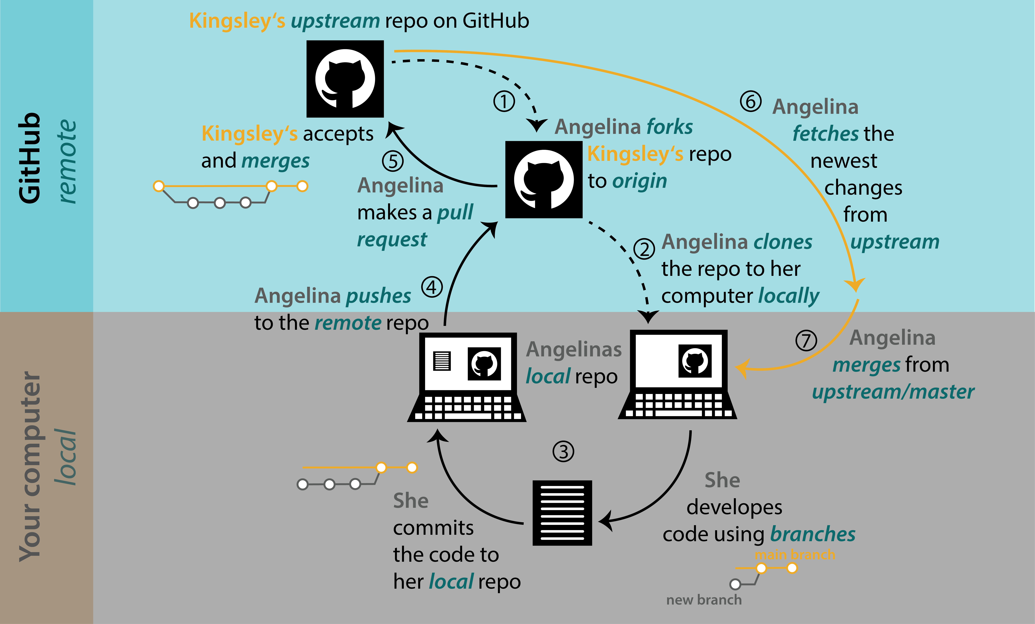
Collaborating with forks
Pull requests are a forum to submit, discuss and accept changes to the group project
biostats-r.github.io

Slide 34
Basic Git commands
Copy repository
Clone to create local version of your remote repository (cloud → local)
Branch to create divergent path from your main repository to isolate new work (internal, specific)
Merge request to ask to incorporate changes of working branch into main branch
Fork to create separate copy of someone else’s main repository (external)
Pull request to ask to incorporate changes of fork into main repository
Upload changes
Commit to add change (+ description of change) to local change-log (local → local)
Push to publish local change-log to online repository (local → cloud)
Download changes
Fetch to retrieve online change-log (cloud → local)
Pull to merge changes of retrieved change-log with local repository (local → local)

Slide 35
Gameplan for group projects
4 groups (2 oceanography and 2 meteorology)
Idunn, Fritjof, Pedro 3 people
Christoffer, Sander, Karen 3 people
Sigrid, Ivar, Nat, Audun 4 people
Kristine, Fiona, Finn, Emil 4 people
Groups get start data, in-between milestones and end goal:
Raw data visualisation
Time-series & Spatial resolution plots
Water and air mass characterisation and visualisation
Combined ocean+atmosphere series with possible interactions
Represent state of ocean+atmosphere in the North Atlantic in 2017, identify events that stand out.
Self-defined roles within group to do, amongst others:
Reading, cleaning, pre-processing data, preparing usable dataframes
Compiling and analysing data
Visualising raw and analysed data
Group members sit separated and get 10min/hour physical meeting time

Slide 36
Collaborative Scientific Python
Code like a modern geophyisicist – Day 4

Slide 37
Previously on CSP… (S1E3)
Branching and submitting merge requests
Create branch on GHD for specific purpose on main project
Work in branch and commit+push to remote
On GL, create merge request into main, assign reviewer, etc.
If branch deleted after merge, open new branch for next specific purpose. If not, continue merge main into branch with GHD and continue working there.
Permissions get inherited from highest group downwards
Users added with role on main group level get same rights in subgroups and projects
Resolve conflict by
Removing users from top level and adding them in selected subgroups or folders
Forking/branching repositories privately to do exercises locally (and opening pull/merge requests to submit, eventually)

Slide 38
Collaborative Scientific Python
Code like a modern geophyisicist – Day 5

Slide 39
Presentation of the work
Prepare presentation
Ocean/Atmosphere groups sit together, push their plots to
global-course-files > Day 3-4-5 Project data > Figures > Atmosphere or Ocean
Each plot needs
Title with description of date, place, plotted quantity (on figure)
Description of phenomenon and behaviour (during presentation)
Further scientific use of plotted information (during presentation)
Groups prepare collective Powerpoint
Complementary plots (different quantities, same time/place)
Time/spatial resolution plots (same quantities, different time/place)
Parallel plots (same quantities, same time/place)
Clemens Spensberger joins us (18:00)
Presentation of the datasets
Ocean plots
Atmosphere plots
Ocean-atmosphere interaction discussion?

Slide 40
What did we learn?
Importance of programming in geophysics
Advantages (and disadvantages) of using Git in scientific projects
Some comments on meaningful learning
Common Python packages for scientific routines
Basic Git commands
Collaborative scientific programming project

Slide 41

Student survey
https://skjemaker.app.uib.no/view.php?id=17135990

